Slide 1
Project Overview
Project Name: Analysis of Food and Beverage Industry Survey Data
Objective: The primary objective of this project is to analyze survey responses from the food and beverage industry to gain insights into consumer behavior, preferences, and perceptions. These insights help identify key trends, understand brand perception, and explore potential areas for improvement in product offerings and marketing strategies.
Data Sources: Three datasets used – fact_survey_responses, dim_respondent, and dim_cities.
Mentorness Internship Project
by Saurabh Mane
Batch Name: MIP-DA-13

Slide 2
Data Description
Content:
Fact Table: fact_survey_responses
Contains response-level data such as consume frequency, brand perception, health concerns, and more.
Dimension Table 1: dim_respondent
Contains demographic details of respondents such as age, gender, and respondent ID.
Dimension Table 2: dim_cities
Contains city information, including city tier classification.

Slide 3
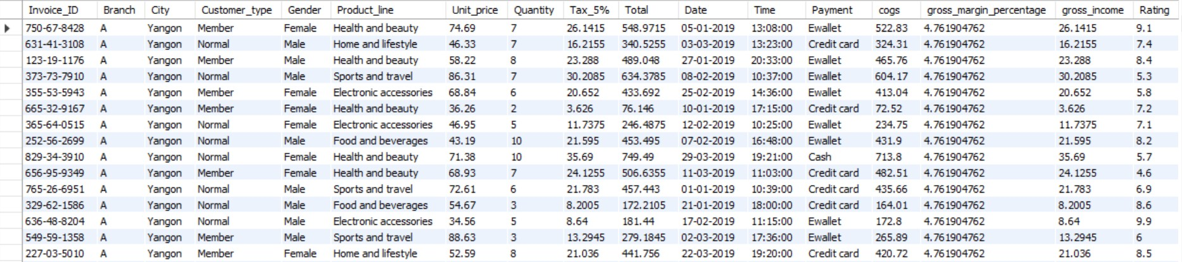
Q.1
Retrieve all columns for sales made in a specific branch (e.g., Branch 'A').
SELECT * FROM WalmartData
WHERE Branch = 'A’ ;

Slide 4
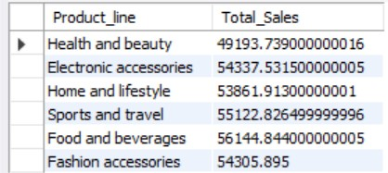
Q.2
Find the total sales for each product line.
SELECT Product_line, SUM(Total) AS Total_Sales
FROM WalmartData
GROUP BY Product_line;

Slide 5
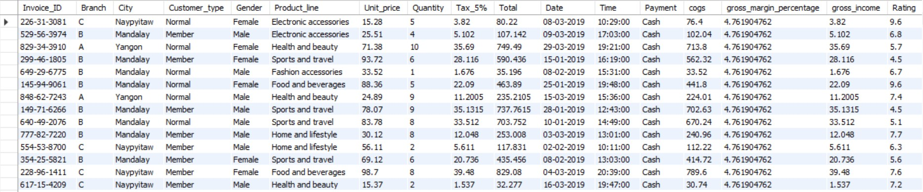
Q.3
List all sales transactions where the payment method was 'Cash'.
SELECT * FROM WalmartData
WHERE Payment = 'Cash';

Slide 6
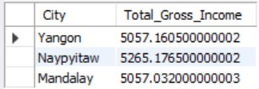
Q.4
Calculate the total gross income generated in each city.
SELECT City, SUM(gross_income) AS Total_Gross_Income
FROM WalmartData
GROUP BY City;

Slide 7
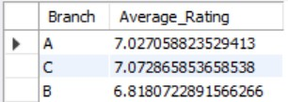
Q.5
Find the average rating given by customers in each branch.
SELECT Branch, AVG(Rating) AS Average_Rating
FROM WalmartData
GROUP BY Branch;

Slide 8
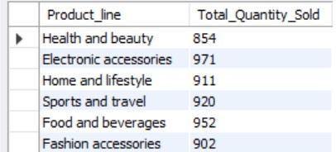
Q.6
Determine the total quantity of each product line sold.
SELECT Product_line, SUM(Quantity) AS Total_Quantity_Sold
FROM WalmartData
GROUP BY Product_line;

Slide 9
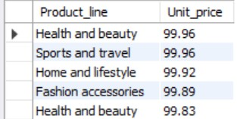
Q.7
List the top 5 products by unit price.
SELECT Product_line, Unit_price
FROM WalmartData
ORDER BY Unit_price DESC
LIMIT 5;

Slide 10
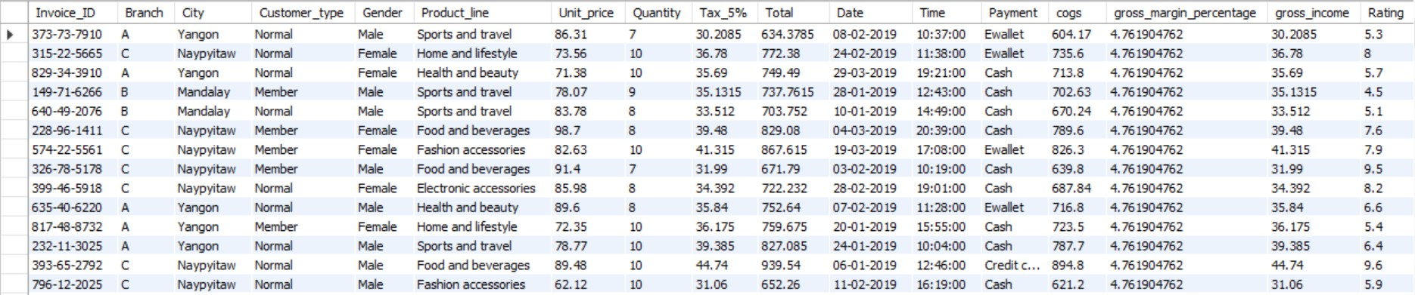
Q.8
Find sales transactions with a gross income greater than 30.
SELECT * FROM WalmartData
WHERE gross_income > 30;

Slide 11
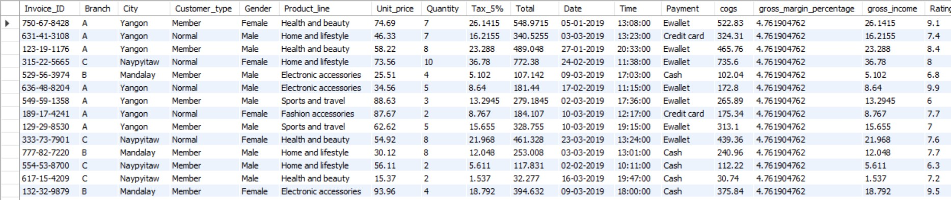
Q.9
Retrieve sales transactions that occurred on weekends.
SELECT * FROM WalmartData
WHERE WEEKDAY(STR_TO_DATE(Date, '%d-%m-%Y')) IN (5, 6);

Slide 12
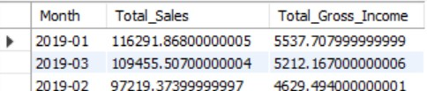
Q.10
Calculate the total sales and gross income for each month.
SELECT
DATE_FORMAT(STR_TO_DATE(Date, '%d-%m-%Y'), '%Y-%m') AS Month,
SUM(Total) AS Total_Sales,
SUM(gross_income) AS Total_Gross_Income
FROM WalmartData

Slide 13

Q.11
Find the number of sales transactions that occurred after 6 PM.
SELECT COUNT(*) AS Transactions_After_6PM
FROM WalmartData
WHERE TIME_FORMAT(Time, '%H:%i:%s') > '18:00:00';

Slide 14
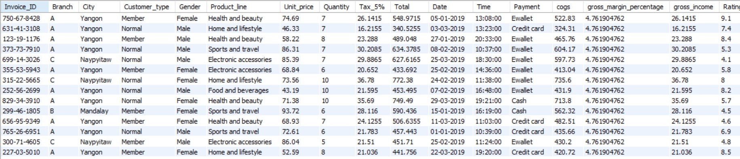
Q.12
List the sales transactions that have a higher total than the average total of all transactions.
SELECT * FROM WalmartData
WHERE Total > (SELECT AVG(Total)
FROM WalmartData);

Slide 15
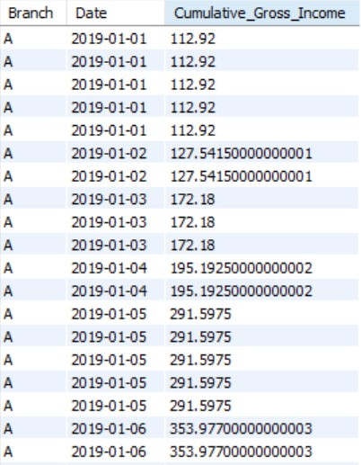
Q.13
Calculate the cumulative gross income for each branch by date.
SELECT
Branch,
STR_TO_DATE(Date, '%d-%m-%Y') AS Date, SUM(gross_income) OVER(PARTITION BY Branch ORDER BY STR_TO_DATE(Date, '%d-%m-%Y')) AS Cumulative_Gross_Income
FROM WalmartData
ORDER BY Branch, Date;

Slide 16
Conclusion
Branch ‘A’ Performance:
Branch A had a high volume of sales, especially in Yangon.
Top Product Lines:
Health and Beauty and Sports and Travel were the best-selling product lines.
City-wise Gross Income:
Yangon generated the most gross income across all cities.
Payment Methods:
Cash and E-wallet were the most used payment methods.
Customer Ratings:
Branch A had an average rating above 8, indicating strong customer satisfaction.

Slide 17

THANKS!

